Slide 1

ASEN 5070
Statistical Orbit Determination I
Fall 2012
Professor Jeffrey S. Parker
Professor George H. Born
Lecture 15: Numerical Compensations

Slide 2
Announcements
Exam 1
Final Project
Homework 5 is not graded…neither is the test.
Homework 6 due Today
Homework 7 due next week (Tuesday!)
It’s okay to use Matlab to compute partials and to output them. But verify them.
Concept Quizzes to resume Monday!
Guest lecturer next week 10/25

Slide 3
Exam 1 Debrief
Too easy?
Too short?

Slide 4
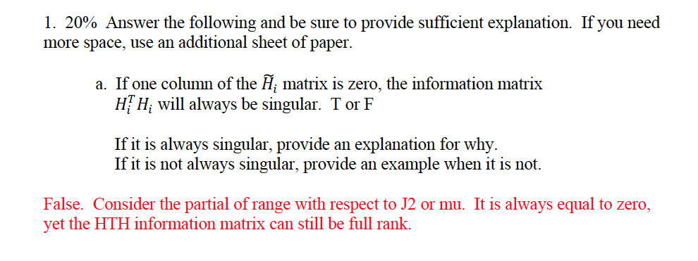
Exam 1 Debrief

Slide 5
Exam 1 Debrief
True. The transpose of a column of zeros becomes a row of zeros. That row propagates through the whole system and the HTH matrix becomes singular.

Slide 6
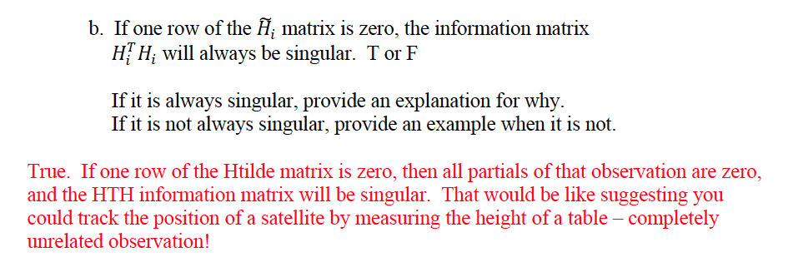
Exam 1 Debrief

Slide 7
Exam 1 Debrief
False. Consider H-tilde = [a, b, 0]^T and Phi = 1.

Slide 8
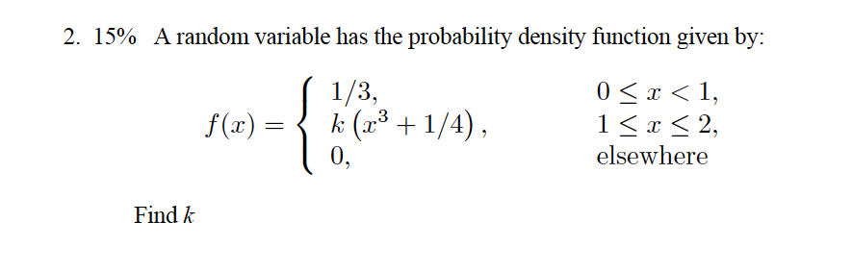
Exam 1 Debrief

Slide 9
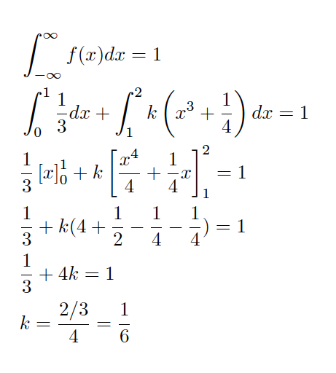
Exam 1 Debrief

Slide 10
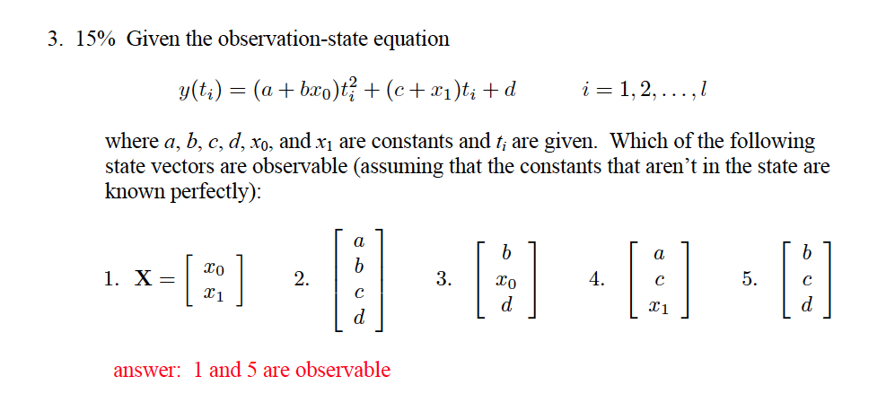
Exam 1 Debrief

Slide 11
Exam 1 Debrief

Slide 12
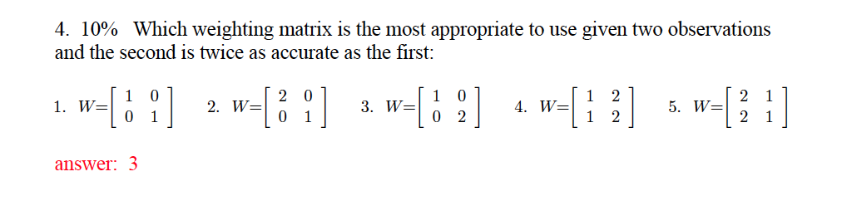
Exam 1 Debrief

Slide 13
Exam 1 Debrief

Slide 14
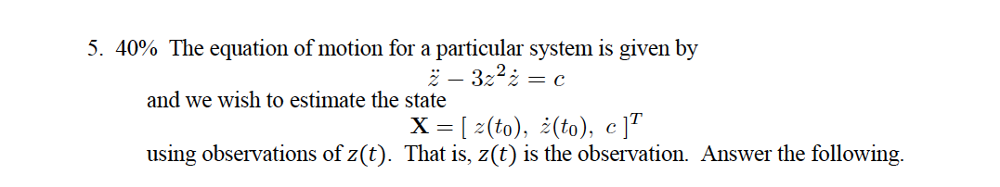
Exam 1 Debrief

Slide 15

Exam 1 Debrief

Slide 16
Exam 1 Debrief

Slide 17
Exam 1 Debrief

Slide 18
Exam 1 Debrief

Slide 19
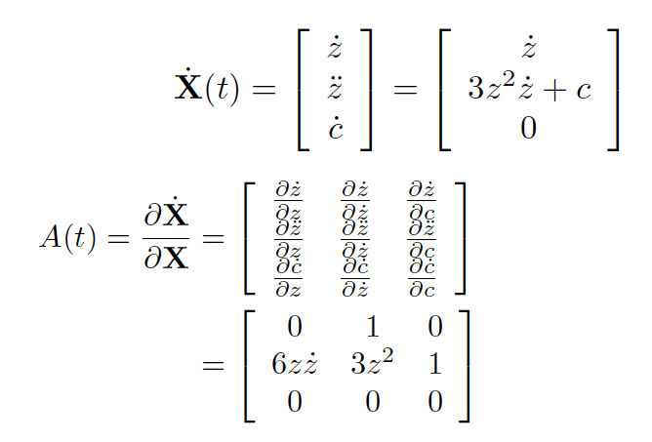
Exam 1 Debrief

Slide 20
Exam 1 Debrief

Slide 21
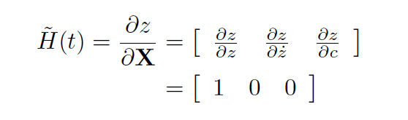
Exam 1 Debrief
G(t) = z(t) is the simplest representation of the observation. If you solve the EOM for z, you can also get partials wrt z-dot and c, which is more information (optional).

Slide 22
Exam 1 Debrief

Slide 23
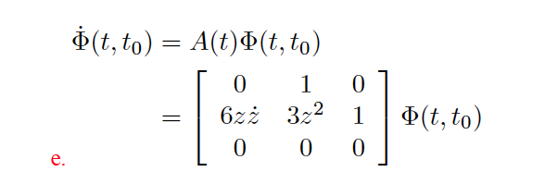
Exam 1 Debrief
Can’t use a Laplace Transform because A(t) is time-dependent!

Slide 24
Exam 1 Debrief

Slide 25

Exam 1 Debrief

Slide 26
Topics coming up
Conventional Kalman Filter (CKF)
Extended Kalman Filter (EKF)
Numerical Issues
Machine precision
Covariance collapse
Numerical Compensation
Joseph, Potter, Cholesky, Square-root free, unscented, Givens, orthogonal transformation, SVD
State Noise Compensation, Dynamical Model Compensation

Slide 27

Stat OD Conceptualization
Full, nonlinear system:

Slide 28
Stat OD Conceptualization
Linearization

Slide 29
Stat OD Conceptualization
Observations

Slide 30
Stat OD Conceptualization
Observation Uncertainties

Slide 31
Stat OD Conceptualization
Least Squares (Batch)

Slide 32
Stat OD Conceptualization
Least Squares (Batch)

Slide 33
Stat OD Conceptualization
Least Squares (Batch)

Slide 34
Stat OD Conceptualization
Least Squares (Batch)

Slide 35
Stat OD Conceptualization
Least Squares (Batch)

Slide 36
Stat OD Conceptualization
Least Squares (Batch)
Replace reference trajectory with best-estimate
Update a priori state
Generate new computed observations
Iterate a few times.

Slide 37
Stat OD Conceptualization
Least Squares (Batch)
Note: the linearization assumption will gradually break down.
Toward the end, the truth will begin to deviate further from the nominal.
Select a measurement interval that balances the number of observations with the length of time being used.

Slide 38
Conceptualization of the Conventional Kalman Filter (Sequential Filter)

Slide 39
Stat OD Conceptualization
Conventional Kalman

Slide 40
Stat OD Conceptualization
Conventional Kalman

Slide 41
Stat OD Conceptualization
Conventional Kalman

Slide 42
Stat OD Conceptualization
Conventional Kalman

Slide 43
Stat OD Conceptualization
Conventional Kalman

Slide 44
Stat OD Conceptualization
Conventional Kalman

Slide 45
Stat OD Conceptualization
Conventional Kalman

Slide 46
Stat OD Conceptualization
Conventional Kalman

Slide 47
Stat OD Conceptualization
Conventional Kalman

Slide 48
Stat OD Conceptualization
Conventional Kalman

Slide 49
Stat OD Conceptualization
Conventional Kalman

Slide 50
Stat OD Conceptualization
Conventional Kalman

Slide 51
Stat OD Conceptualization
Conventional Kalman

Slide 52
Stat OD Conceptualization
Conventional Kalman

Slide 53
Stat OD Conceptualization
Conventional Kalman

Slide 54
Stat OD Conceptualization
Conventional Kalman

Slide 55
Stat OD Conceptualization
Conventional Kalman

Slide 56
Stat OD Conceptualization
Conventional Kalman

Slide 57
Stat OD Conceptualization
Conventional Kalman

Slide 58
Stat OD Conceptualization
Conventional Kalman

Slide 59
Stat OD Conceptualization
Conventional Kalman

Slide 60
Stat OD Conceptualization
Conventional Kalman
Evolution of covariance
Mapping of final covariance

Slide 61
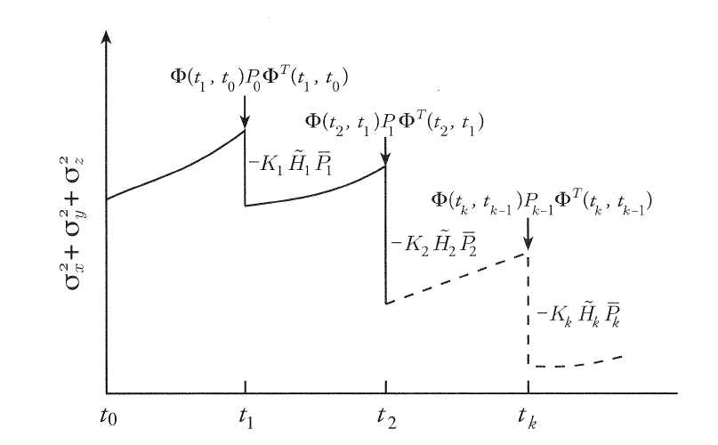
Evolution of Covariance Matrix
Evolution of the covariance matrix as observations are processed.

Slide 62
Conceptualization of the Extended Kalman Filter (EKF)
Major change: the reference trajectory is updated by the best estimate after every measurement.

Slide 63
Stat OD Conceptualization
EKF

Slide 64
Stat OD Conceptualization
EKF

Slide 65
Stat OD Conceptualization
EKF

Slide 66
Stat OD Conceptualization
EKF

Slide 67
Stat OD Conceptualization
EKF

Slide 68
Stat OD Conceptualization
EKF

Slide 69
Stat OD Conceptualization
EKF

Slide 70
Stat OD Conceptualization
EKF

Slide 71
Stat OD Conceptualization
EKF

Slide 72
Stat OD Conceptualization
EKF

Slide 73
Stat OD Conceptualization
EKF

Slide 74
Stat OD Conceptualization
EKF

Slide 75
Stat OD Conceptualization
EKF

Slide 76
Stat OD Conceptualization
EKF

Slide 77
Stat OD Conceptualization
EKF

Slide 78
Stat OD Conceptualization
EKF

Slide 79
Stat OD Conceptualization
EKF

Slide 80
Stat OD Conceptualization
EKF

Slide 81
Stat OD Conceptualization
EKF

Slide 82
Stat OD Conceptualization
EKF

Slide 83
Stat OD Conceptualization
EKF

Slide 84
Stat OD Conceptualization
EKF
Final mapped Reference
Evolution of reference, w/covariance
Original Reference

Slide 85
Stat OD Conceptualization
Linear Regime
Pitfall 1: Beware of large a priori covariances with noisy data - Breaks linear approximations - Causes filter to diverge

Slide 86
Stat OD Conceptualization
Pitfall 2: Beware of collapsing covariance - Prevents new data from influencing solution - More prevalent for longer time-spans

Slide 87
The End
Final Project
Homework 5 is not graded…neither is the test.
Homework 6 due Today
Homework 7 due next week (Tuesday!)
It’s okay to use Matlab to compute partials and to output them. But verify them.
Concept Quizzes to resume Monday!
Guest lecturer next week 10/25

